Slide 1

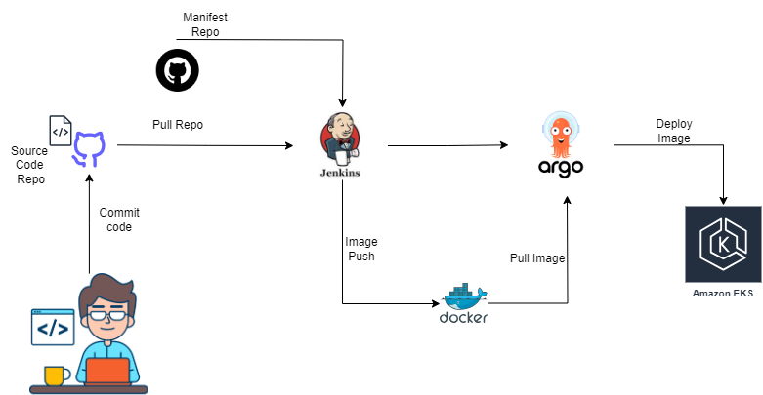
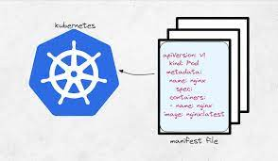
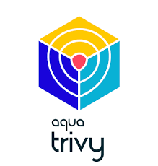
Project Architecture

Slide 2
Project Work Flow
Provisioning Infrastructure
01
Jenkins Master and Slave, EKS Bootstrap server
02
Tools Integration
Maven,JDK, Docker, Argo CD & EKS
CI Setup
03
Build and Push Docker Image to Hub using Jenkins and scan the image using trivy
CD Setup
04
Argo CD should pull deployment & update latest image tag then it should deploy on EKS cluster

Slide 3

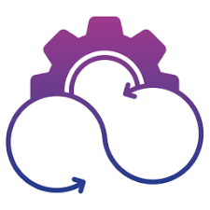
SETTING-UP CI PIPELINE
Phase I:
Clean the workspace before start
My mvn goal is to test
I need only last two builds history be visible in Jenkins
To Build and push docker image to docker hub
Docker hub repository should create from CI pipeline
Use trivy to scan docker image
Phase II:
Create a bootstrap server ( EC2 ) for EKS and ArgoCD
Use EKSCTL to create EKS cluster
Argo CD Integration with EKS Cluster

Slide 4


Create A DockerFile with Below Instructions
User Tomcat latest Image
copy all the content which is webapps.dist to webapps directory
copy WAR /webapp/target to tomcat/webapps directory

Slide 5



SETTING-UP CD PIPELINE
CD should trigger after updating Image Tag in CI &
Deploying latest Docker on EKS using Argo CD

